Slide 1
New Institutions and Practices in the Hungarian Child Protection System By: Havasi virág ISCI 2019
EFOP-3.6.2-16-2017-00007

Slide 2
Situation of children in Hungary
Hungarian population: 9, 798, 000 (2017)
1, 694, 396 children (age 0-14) (census, 2011)
19.2% of children( 400,000) were living in severe material deprivation (KSH 2019)
the category of children who live permanently on the streets is virtually nonexistent, with the exception of addicted youngsters and immigrant children (some beggar families from Romania)

Slide 3
Situation oF Gypsy children
the number of the Gypsies: 876 000, credible estimates 13% of children’s population is Romani
less than half but more than a third of the Hungarian Gypsies lives in deep poverty and the same is true for the rate of Gypsies among the extremely poor people
three quarters of the Gypsies lives at risk of poverty and social exclusion
55.5% of Gypsy children are living in severe material deprivation
Residential and school segregation (In 15% of schools the percentage of Gypsy children was over 40%, in 10% of schools it was more than 50%. There were 52 schools where 90% of the students were Gypsy and in 34 schools it was 95%. The competency results showed that when the proportion of Gypsy students rose above 10% the average school performance began to decrease)
Early school leaving, low educational level (6.97% of Gypsy children do not finish primary school, 4.39% do not enroll in secondary or VET school, 42.35% drop out of secondary or VET schools, 24.69% obtain vocational school qualifications, 21.59% pass leaving exams and complete secondary school, 4.21% start higher education)

Slide 4
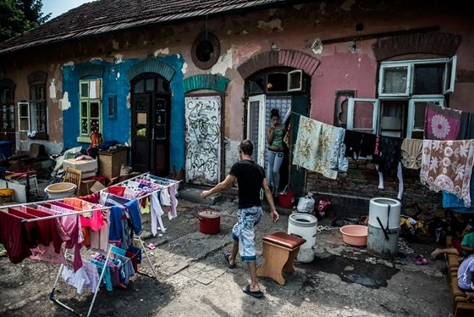
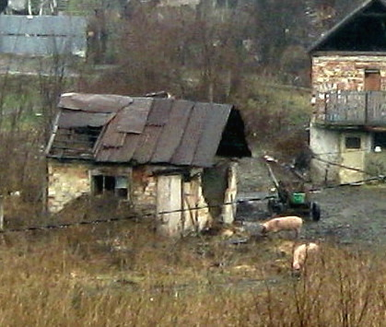
Hungarian slums

Slide 5
Children in the child protection system (2011)
Abused and neglected children
Minors of risk registered for reasons of
Physically abuse 3 127
Psychically abuse 5 499
Sexually abuse 374
Total abuse 9 000
Physically neglect 12 362
Psychically neglect 9 741
Total neglect 22 103
Environment (47 151)
Behaviour (51 041)
Means (92 146)
Health (7 610)

Slide 6
The structure of the child protection system
Financial supports, benefits in-kind (e.g. regular child benefits, free or cheap meals in educational institutions, free course books, after-care provision)
Basic social services
Professional social services
Administrative measures (placement under protection, taking the child out of its family and acceptance of the child in another family (családba fogadás), temporary placement (ideiglenes hatályú elhelyezés), foster care (nevelésbe vétel), adoption)

Slide 7
Basic services
Basic care level’s aims: preventing child endangerment and facilitating the bringing-up of children in families
family and child welfare services in settlements, family and child welfare centres in districts
financial support and benefits-in-kind,
child welfare service: individual case management of the endangered child, family in-team work aimed at eliminating the endangering factors, and the provision of services aimed at meeting the children’s daily needs, or the full or partial takeover of the child’s care on a temporary basis (voluntary)
day-time care of children and temporary care of children, parents can request to get their children back at any point
parental rights of supervision are not affected at this time,
Placement of children with substitute parents/ in Children’s temporary home (1200 children)/ temporary home for families (6200 children) (for a maximum of 12 months)
Creche, alternative daytime programs, study halls, sure start children’s houses
Indication system

Slide 8
professional child protection services
home-like provisions: children’s homes, foster parents, apartment home
After care
county professional child protection services (tgysz)

Slide 9
Problems 1
Underfunding
Low salary
labour shortage in the social sphere,
overload
Lack of professional knowledge (complex knowledge would be necessary, professional training after graduation is compulsory but costly)
Burn-out (supervision: missing or not compulsory and many social workers do not participate)
Not enough means in the hands of the social workers
Preventive social care and community development in Hungary are underdeveloped (but SSCH, SH)
Organization of alternative daytime and holiday programs: has only a legal definition, but the Goverment does not provide sources per capita, it has been granted only by NGOs

Slide 10
Problems 2
the broad definition of endangerment and its application which results in children being removed from their families for material reasons, though this is banned by law ( territorial differences in the country- Romani children appear to be removed more frequently from their families for material reasons than non-Romani children)
The chance for children taken out of their family to go back to their own family is low
Dilemmas of Chilren’s home, apartment homes, foster parents
Long time in temporary placement
Gypsy children are overrepresented in the system, Regarding identity questions there are challenges in the system: identity crisis because they grow up with a weak sense of ethnic identity in the absence of their parental or community influence and input, and may even experience rejection by this community, although they will also most likely be treated as a member of the Romani community by non-Roma

Slide 11
Problems 3 (Adoption)
the majority of adoptive parents are non-Romani adults who are unwilling to adopt Romani children for reasons ranging from anti-Romani attitudes, to a lack of preparation to take on a Romani child, to pressure from the surrounding environment, to fear of being incapable of raising a Romani child
potential adopters reportedly refuse en masse to adopt children with disabilities
Romani children are more likely than non-Romani children to be labelled with a mental disability or special learning need they are at a double disadvantage regarding the identification of suitable adoptive families
In 2017 21 000 children received special care, 1972 of them were adoptable and 1025 were adopted (234 to abroad)

Slide 12
Sure start children’s house
SSCHs:
- provide children with meals and skill development activities on a daily basis and survey their conditions regularly,
- provide parents with the possibility of participation in activities together with their children, special personality and capacity development and other preventive programmes,
- organise community events

Slide 13
SSCH
The idea and methodology were developed and tested in the UK
The Hungarian adaptation of the programme began in 2003 (first with EU funds, now partly from domestic resources)
Now 265 SSCHs are functioning (3155 settlements in HU)
Since 2018 Child protection act
Problems (not enough, lack of professionals, not exploited, the poorest people do not use)

Slide 14
„Tanoda” study hall
Study halls are:
providing a learning space for disadvantaged pupils;
identifying and supporting gifted children;
reducing early school leaving, grade repetition and unemployment
providing extra-curricular activities for disadvantaged young people;
improving cultural life;
developing social skills for employment;
offering guidance
After school
Run by NGOs and churches

Slide 15
SH
The first study hall was opened in a disadvantaged district of Budapest (Józsefvárosi Tanoda) in 1995
After 2004 study halls were established with the support of EU funds
In 2018 Study halls have become incorporated into the child protection act and the means of domestic financing is being formulated just now
274 study halls were functioning in 2018
Problems (rent seekers, not enough, conservative teaching methods in some places)

Slide 16
Conclusions
Good ideas in underfunded system, lacking quality control
(expenditure on social protection in HU 19,1% of GDP in 2016, while EU 28 average was 28,1%
On child protection HU spends 2,3% of its GDP)

Slide 17
Köszönetnyilvánítás
A kutatást az EFOP-3.6.2-16-2017-00007 azonosító számú, Az intelligens, fenntartható és inkluzív társadalom fejlesztésének aspektusai: társadalmi, technológiai, innovációs hálózatok a foglalkoztatásban és a digitális gazdaságban című projekt támogatta.
A projekt az Európai Unió támogatásával, az Európai Szociális Alap és Magyarország költségvetése társfinanszírozásában valósul meg.

