Slide 1
Patterns of Conflicts with and within the romani population in Hungary Havasi Virág
EFOP-3.6.2-16-2017-00007

Slide 2
First appearance in Hungary: 15th century
Main groups: Vlach, Boyash, Hungarian
2011 census: 315 583
1/3-1/2 of the Roma lives in deep poverty, and 1/3-1/2 of people living in deep poverty has Romani origin
Education:
segregated schools in connection with residential segregation/ segregated classes (bilingual classes, higher level maths)
High drop out rate in secondary school/ Roma students in secondary schools providing final examinations is below 15 per cent/
2 per cent of young Roma begin their studies in higher education and 0.5 per cent obtains a degree
Labour market….labour shortage, public work schemes, working abroad

Slide 4
Our recent research targeted:
Post industrial town (Ózd)
Small village in an agricultural territory (Fulókércs)
413 inhabitants, 80% Roma, 40% children

Slide 5
Conflicts on institutional level, politics
Corruption
School and its maintainer (KLIK)
„Here people do not politicize…”
„Everyone voted for Fidesz, because we are afraid of the immigrants”
People have fear from the right wing parties
„If we got help from one side, we would support it”

Slide 6
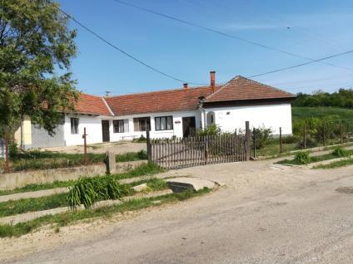
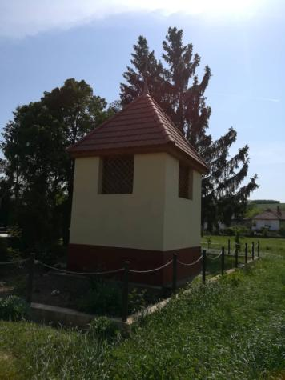
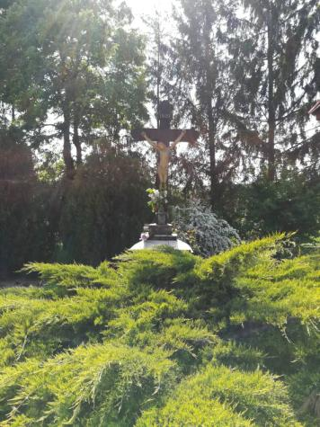
The new gypsy mayor
Earlier mayor
(uneducated, alcoholic non-gypsy)
Failor in his first attempt
Tanoda, public
forum
„Good boss”

Slide 7
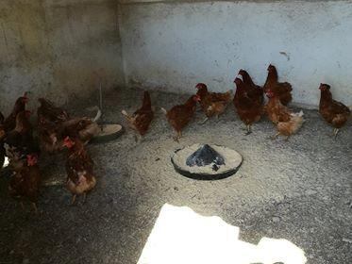
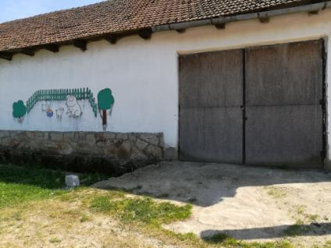
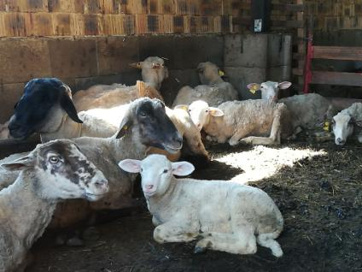
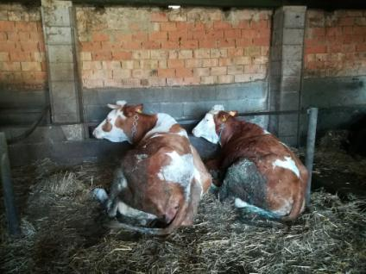
Public work
Number of public workers (NLO)
Who can work?
The work what has to be done

Slide 8
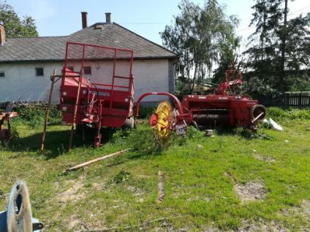
Problems with public work
„We consider public work ridiculous. But we need to give work and income to the people”
„Public work
„Public work is lengtening of social subsidy.”
Accusation, frequent control
„Situation of enterprises is harder. We cannot compete with payed idleness”

Slide 9
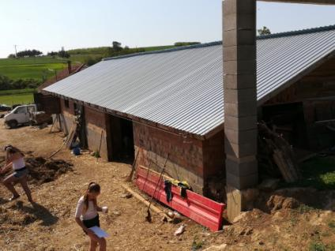
Labour market
Bosch and some SME
Public institutions
Social cooperative (forestry)

Slide 10
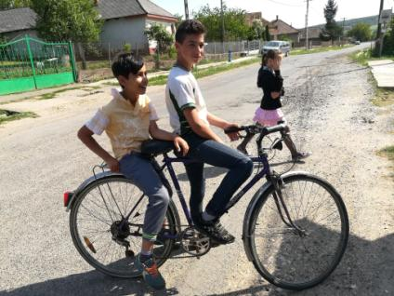
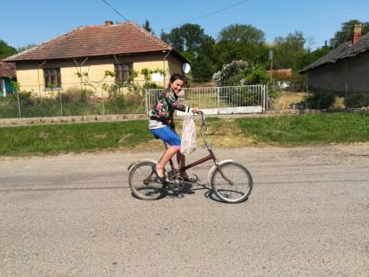
Institution-individual
School: feeling of discrimination (first in gypsy-non gypsy relation, then differentiation between the families)
Police: monthly problems (abusing of power: fines)

Slide 11
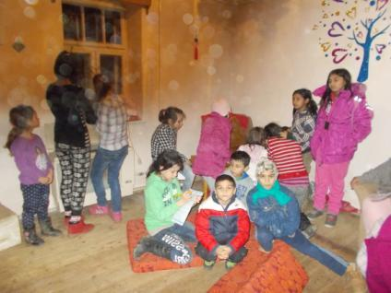
School-Tanoda
„I do not agree with the principles of upbringing of many families, children’s place is in the school”
1-3 grades in the village
Tanoda-60 children

Slide 12
Gypsy-non gypsy
Typical problems
Fulókércs
Stealing
Cutting fruit trees
Different behaviour (more impulsive, shouting)
Run-down buildings, lack of hygiene (home and body)
Mutual hostility
In the past, strangers
In the past
The same
Some families
Respect, we were raised up tugether

Slide 13
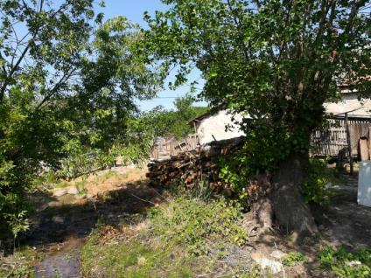
Stealing
Winter firing
Most of the families cultivate their gardens and public workers get from the products

Slide 14
Conflicts between one gypsy with the other
Here and elsewhere
Elsewhere but not here
Debates between neighbours (fights, causing harm)
Gossip, situative truth
Fights under the influence of alcohol
Envy
Debates on legacy
Constant quarrels between the husband and wife in some families
„Indigenous- newcomer”
They do not let in strangers
90% of population has name of Mata, Dávid, Putnoki
Usury

Slide 15
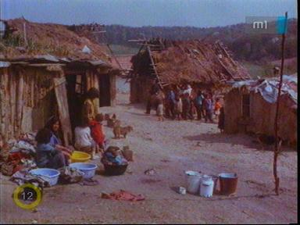
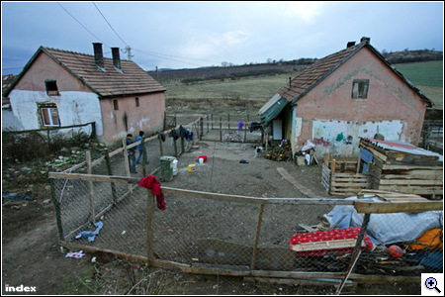
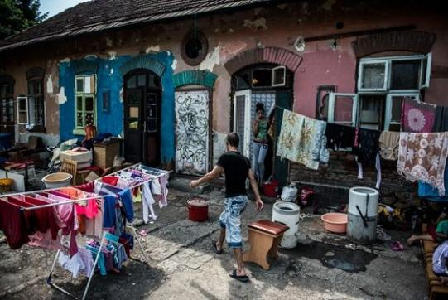

Slide 16
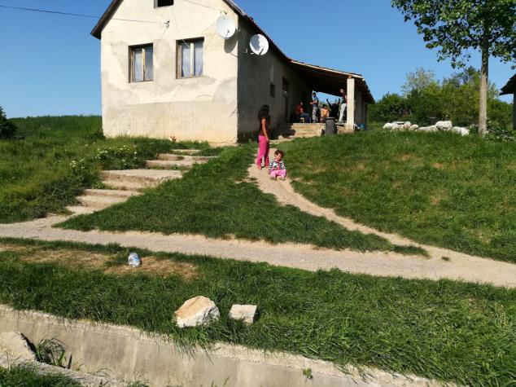
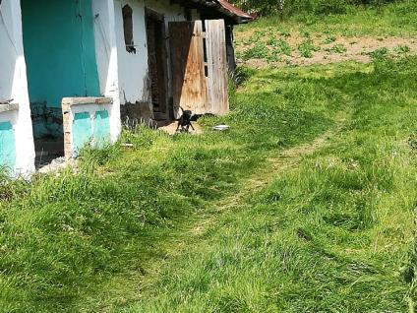
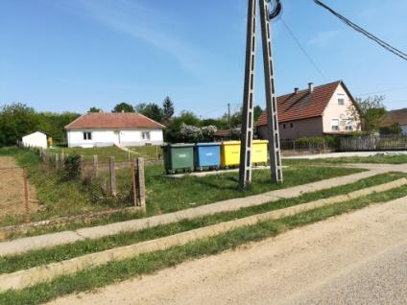
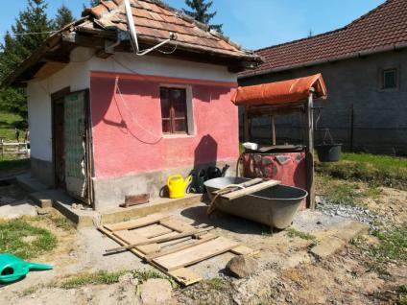
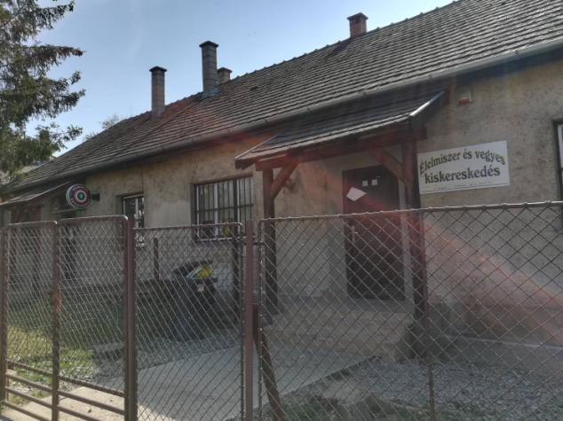
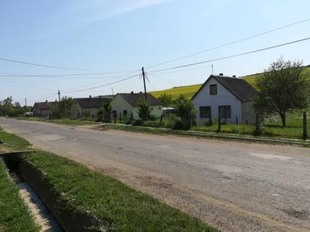
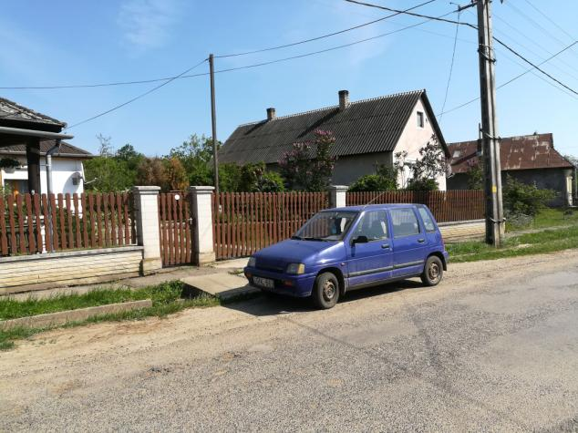
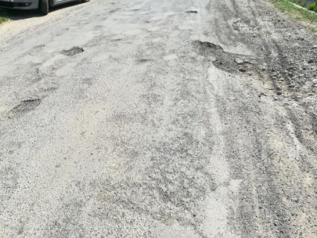

Slide 17
Köszönetnyilvánítás
A kutatást az EFOP-3.6.2-16-2017-00007 azonosító számú, Az intelligens, fenntartható és inkluzív társadalom fejlesztésének aspektusai: társadalmi, technológiai, innovációs hálózatok a foglalkoztatásban és a digitális gazdaságban című projekt támogatta.
A projekt az Európai Unió támogatásával, az Európai Szociális Alap és Magyarország költségvetése társfinanszírozásában valósul meg.

Slide 18
Thanks for attention!

